Slide 1
Building Canvas Apps with ASP.NET and Azure
Nathen Drees
Developer
ndrees@sonomapartners.com
@nadrees

Slide 2
Nathen Drees
Sonoma Partners, LLC
Lead Salesforce Developer, .NET Developer
Notes:
Work for Sonoma Partners
Lead Salesforce Developer, .NET Developer
Presenting on behalf of Microsoft

Slide 3
Integrations
Because no system exists in a vacuum
Notes:
Most interesting/challenging
Multiple systems
ERP
CRM
Custom Applications
Systems need to talk to each other
Most people think of…

Slide 4
Data Integrations
Scheduled Jobs
ETL
Duplicate detection & cleansing
Etc.
Notes:
Data focused
Invisible to the end user
Value, not focus
Lots of documentation
Developer blog/search engine
Today focus on…

Slide 5
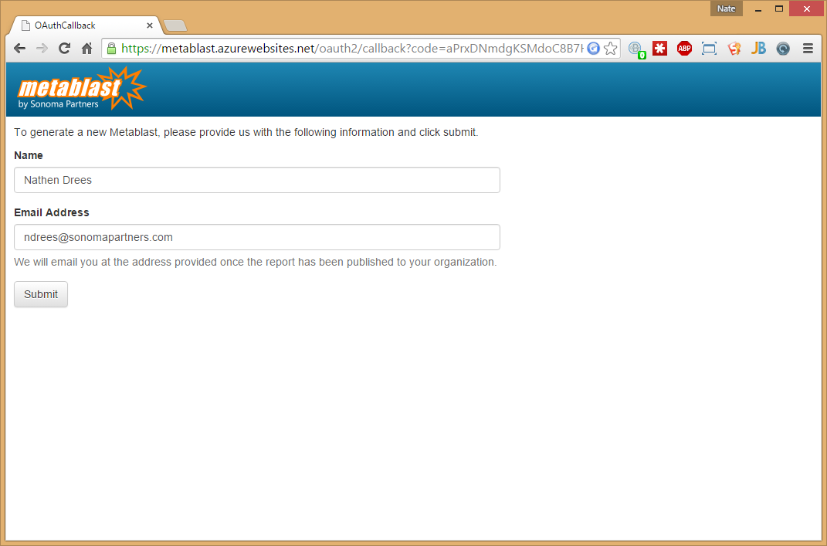
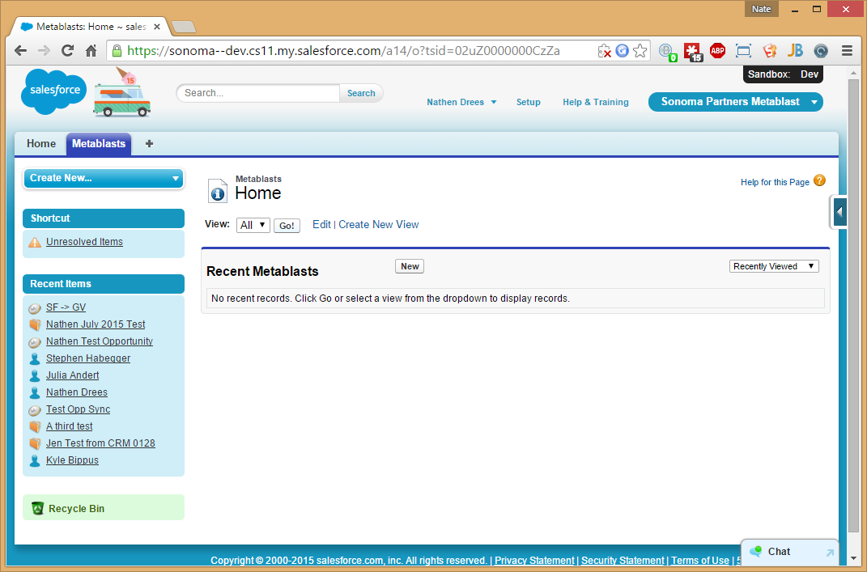
Application Integrations
Notes:
Salesforce window
User clicks on button
Taken to new application
Visible to end users
Own set of challenges
Must “flow” to be effective
Little friction
May require extra training for end users
From Development side…

Slide 6
Application Integrations
Retrain developers to be able to develop in both technologies
Authentication and maintaining user context can be challenging
Breaks user experience
Notes:
Retrain
Salesforce + ASP.NET
Doubled training costs
Authentication + user context
Do not reauth
Pass along record context
Seemless
Breaks user experience
Ideal case…

Slide 7
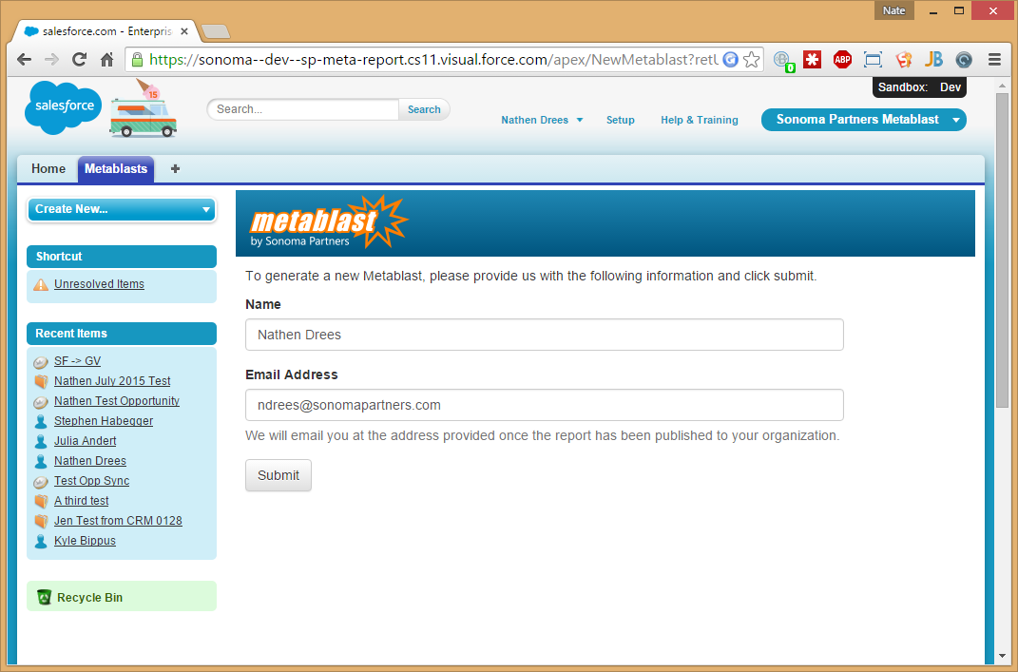
Application Integrations
Notes:
Embed ASP.NET applications within Salesforce
We can by using…

Slide 8
Canvas
Not just something you paint on. (Happy little trees.)
Notes:
Frames an external ASP.NET application within Salesforce
Securely passes the user context to the application
Maintain user context
Maintain record context
Allows cross-application communication
Maintain user flow
Even better
Minimal developer retraining needed
Easy
Demo live starting right after…

Slide 9

Canvas
Notes:
Can’t cover everything
Link at end of presentation

Slide 10
Time to code

Slide 11
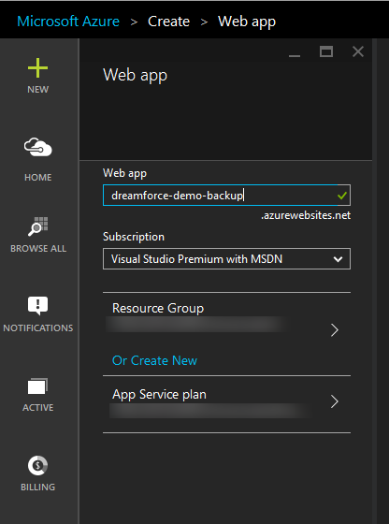
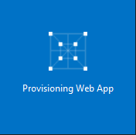
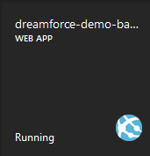
Create Website
Notes:
Using azure to host web site
Creating in azure first, and using publishing profile to deploy
Can also create directly from visual studio, if your permissions allow

Slide 12
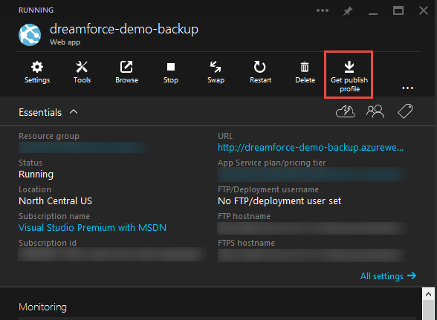
Get publish profile
Notes:
Retrieving publish profile from created site

Slide 13
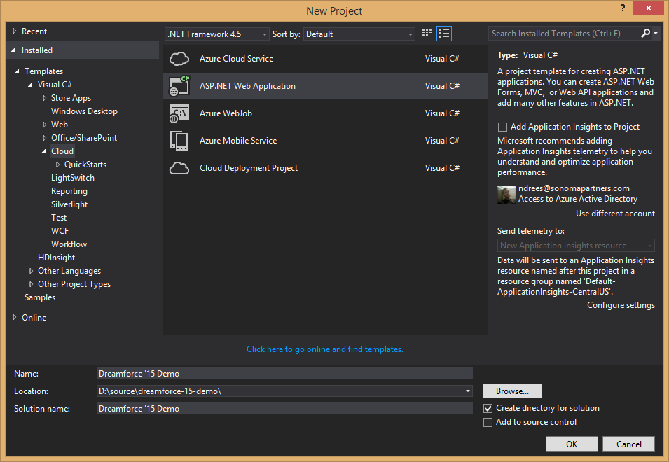
Create Sample Site
Notes:
Creating a sample ASP.NET site for demo purposes

Slide 14
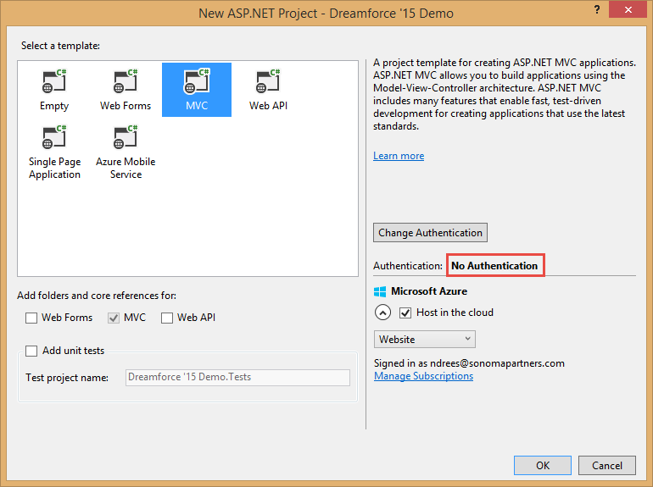
Create Sample Site
Notes:
Using MVC framework, with no authentication for minimum needed deployment.

Slide 15
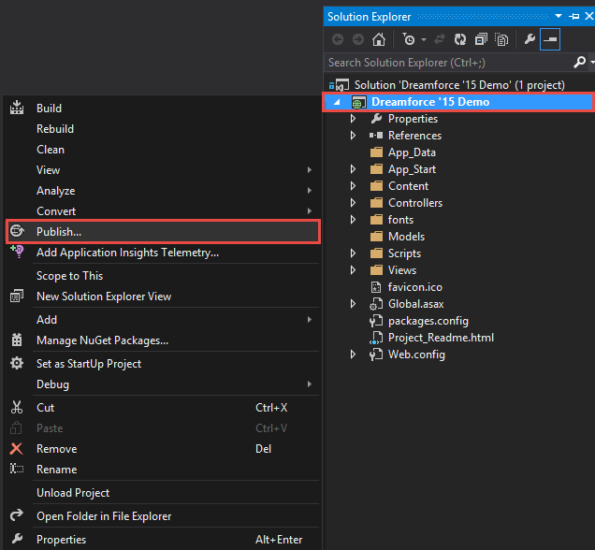
Publish to Azure

Slide 16
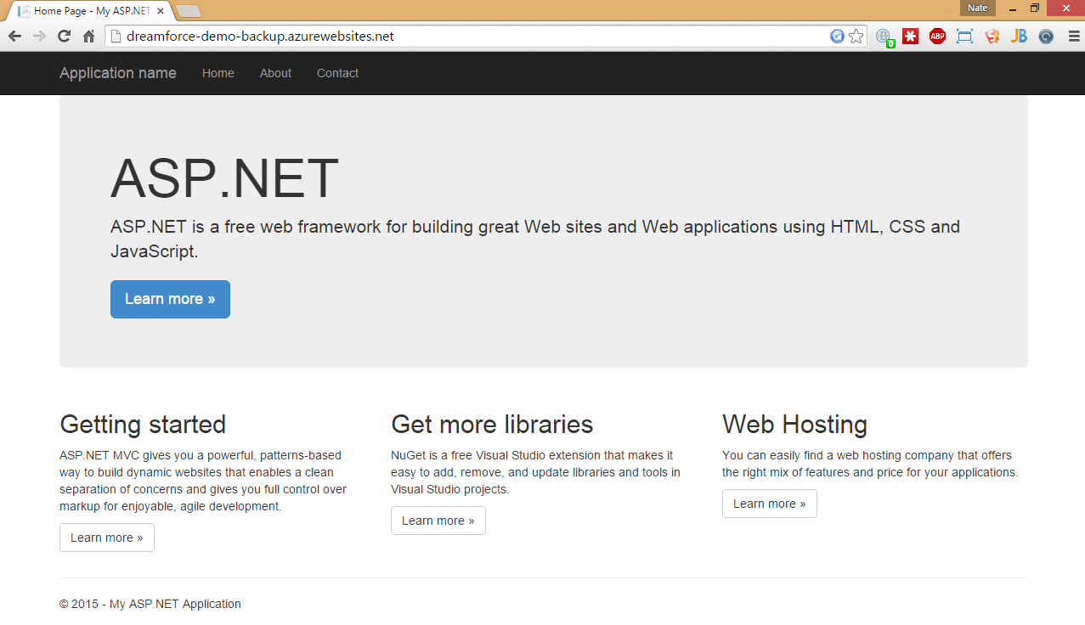
Site is live

Slide 17
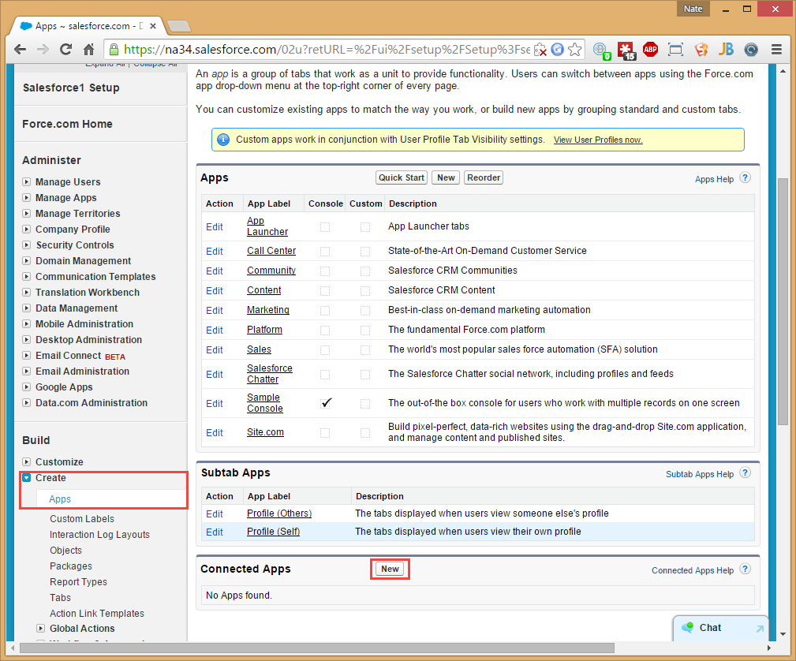
Create Connected Application
Notes:
Some setup in Salesforce needed.
Create a connected application
Tells Salesforce what url it will be framing, and how authentication will work
The metadata can be pushed in to the various orgs you want to deploy to

Slide 18
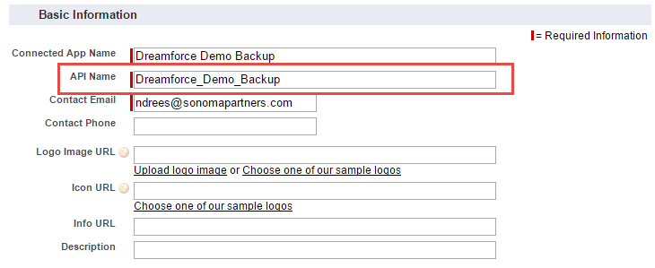
Create Connected Application
Set application name
Notes:
Name your application.
Take note of the API name, which you will need later.

Slide 19
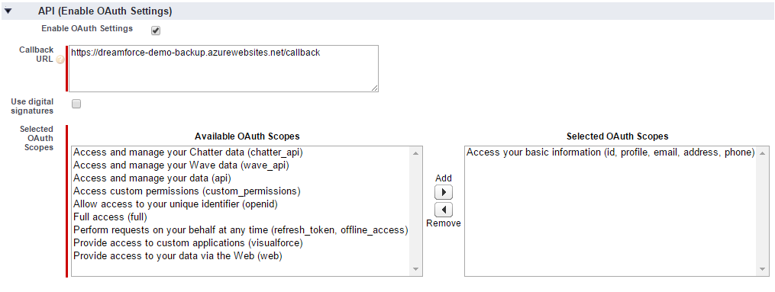
Create Connected Application
Enable OAuth
Notes:
OAuth is required for the connected app to be recognized as a canvas app
Select the minimum scope necessary to get the information you need

Slide 20
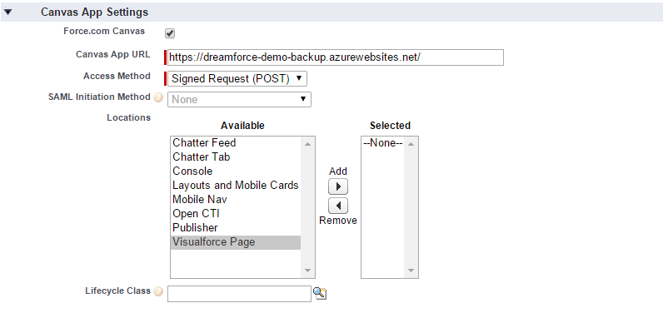
Create Connected Application
Enable Canvas
Notes:
Need to enable canvas for this connected application.
Canvas App URL is entry point when your application is accessed via Canvas
Access Method defines authentication method
Leave as Signed Request (POST) in most cases
Locations
defines where the canvas app may appear in Salesforce
Select as many or as few as needed
Can leave as blank to just preview in the canvas app previewer (next)
Save your application

Slide 21
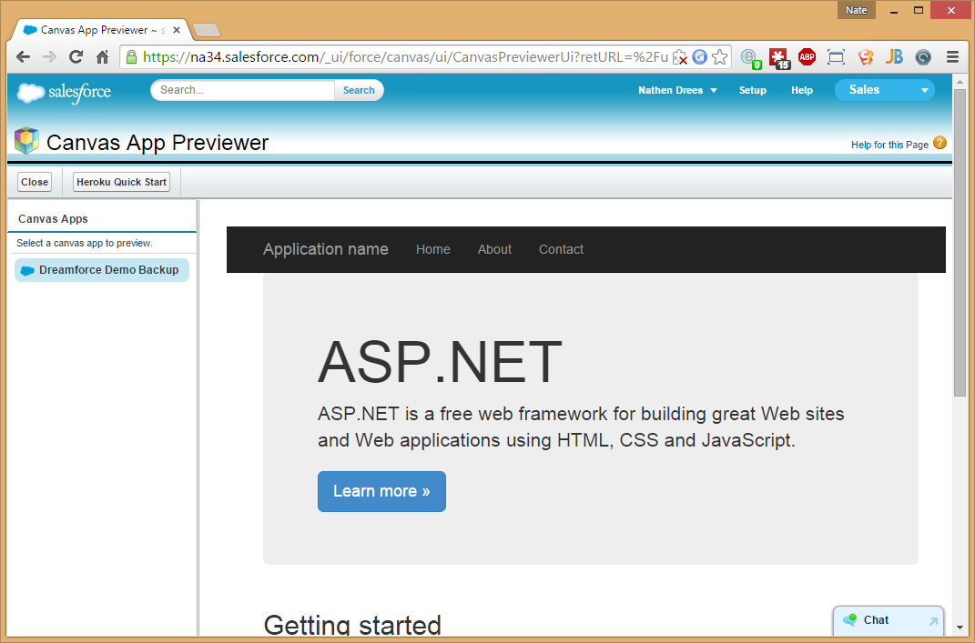
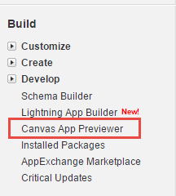
View your embedded application
Notes:
Can use the previewer to view you canvas app without having to deploy it anywhere inside Salesforce
Useful for debugging canvas related problems, without dealing with the other parts of the system.

Slide 22
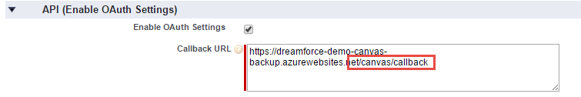
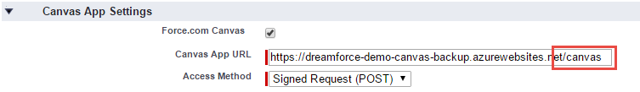
Adding Authentication
Update Application Settings
Notes:
Need to update app settings to allow time for changes to propagate
Change settings to match quick start settings (upcoming)

Slide 23
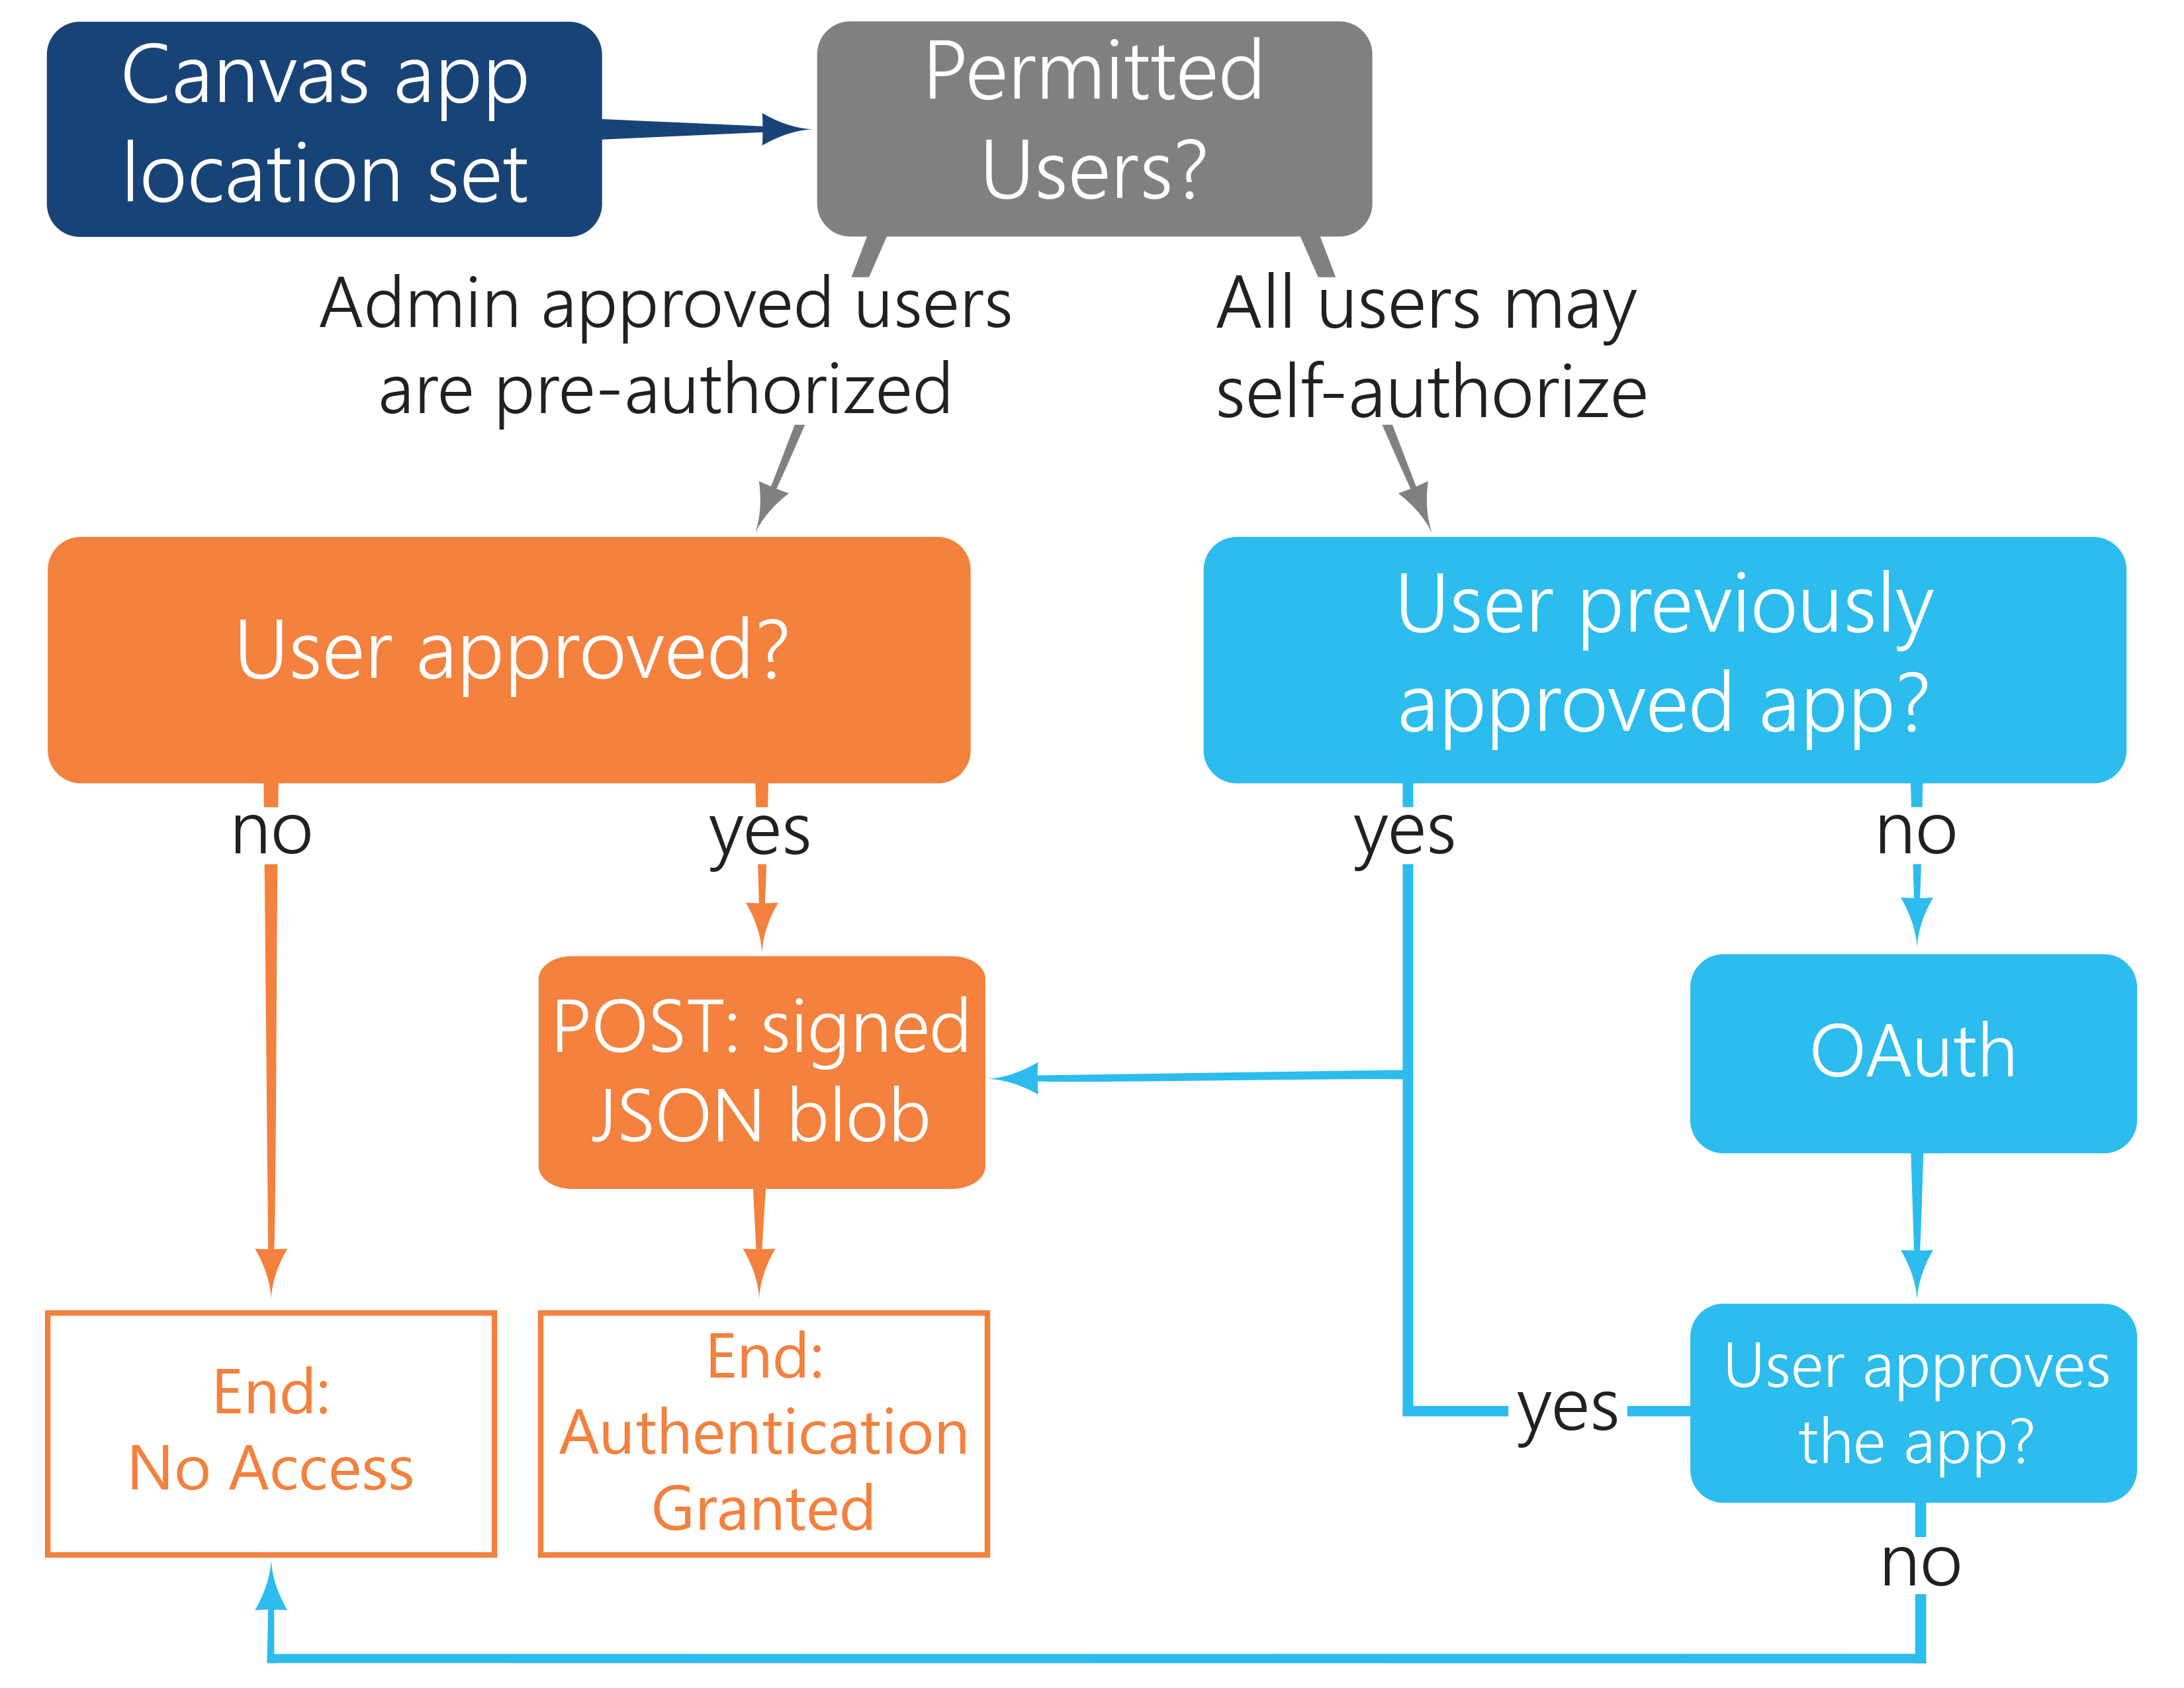
Adding Authentication
Notes:
Maintains user context
2 authentication routes, depending on how app is configured when installed
Admin pre-approves users
Users my self authorize
App needs to be able to handle both

Slide 24
.NET Canvas Starter Kit
Url: https://github.com/sonomapartners/.NET-Canvas-Starter-Kit
Contains:
Pre built starter controller that handles authentication
Pre built starter views
Pre built JavaScript to initiate OAuth flow

Slide 25
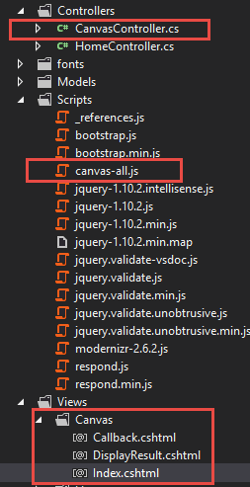
.NET Canvas Starter Kit
Notes:
Copy highlighted files in to your project

Slide 26
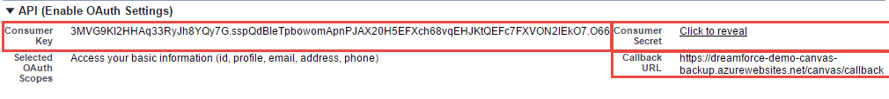
Gather OAuth parameters
Notes:
Settings can be found in Setup > Create > Apps > <app name>

Slide 27
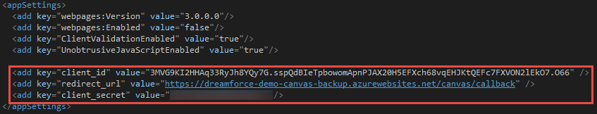
Update Web.config
Notes:
Add 3 keys to Web.config
client_id = Consumer Key
redirect_url = Callback URL
client_secret = Consumer Secret
Deploy

Slide 28
Testing authentication
Change connected application authentication settings
Setup > Manage Apps > Connected Apps > <your app> > Edit > Permitted Users
Test Application in Canvas App Previewer with both settings

Slide 29
Recap
Canvas allows
Integrating external apps inside Salesforce
Maintaining user context across applications
Minimizing developer retraining needed
.NET Canvas Starter Kit makes getting started easy

Slide 31
Links
Salesforce Developer Org: http://developer.salesforce.com
Force.com Canvas Developers Guide: https://developer.salesforce.com/docs
.NET Canvas Start Pack: https://github.com/sonomapartners/.NET-Canvas-Starter-Kit
Follow me: @nadrees
Sonoma blog: http://blog.sonomapartners.com
Personal blog: http://nadrees.com

